Slide 1
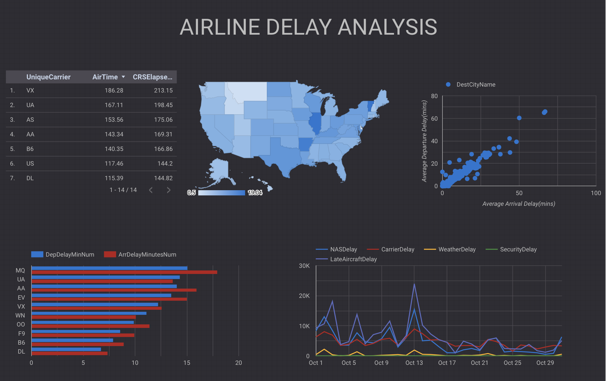

Airline Delay Analysis
Dashboard made using google data studio
Pranav Vinod
Umassd id: 01984464
POM 681: Business analytics and data mining

Slide 2
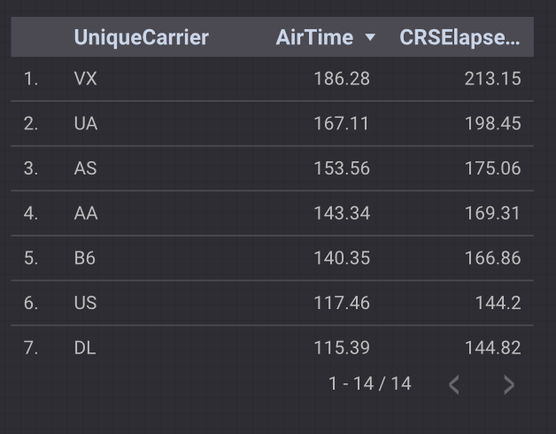
Airtime overview
This table gives an overview of the average actual airtime and the average CRS elapsed airtime of different carriers.
All carriers have an average flying time that is less than their CRS airtime.

Slide 3
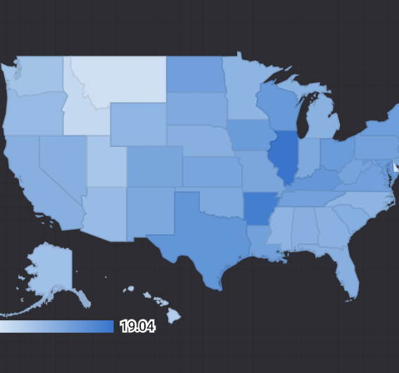
Delay Analysis by state
The geospatial visualization shows the variation of average departure delay time with different states.
There is an optional metric of average arrival delay to check its variation per state.
We can see that the most delays were in the state of Illinois and Vermont.

Slide 4
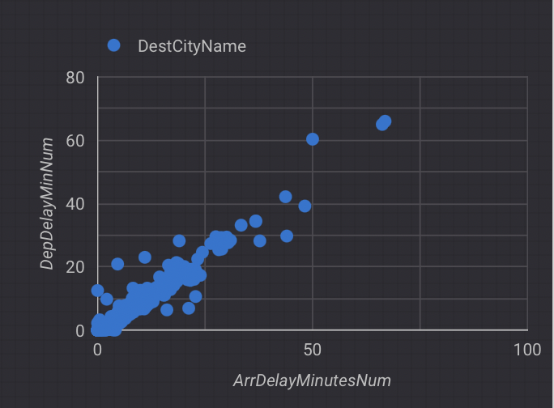
Delay analysis by city
The scatter plot shows relation between departure delay and arrival delay for different cities.
We can see a linear relation between the delay in departures and arrivals at different airports.

Slide 5
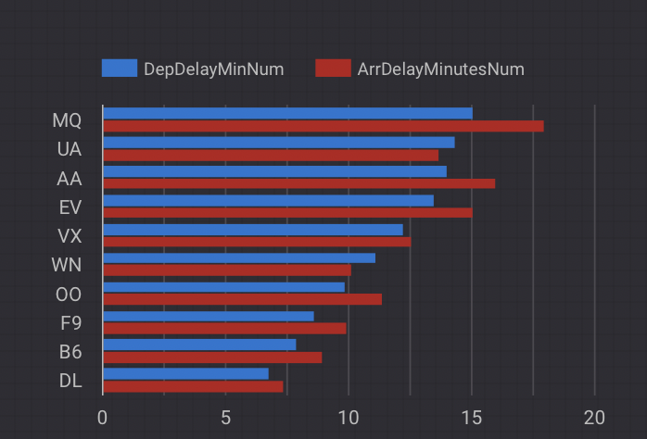
Total delay per carrier
This bar chart shows the average departure delay and average arrival delay in minutes for the top 10 carriers.
We can learn that most carriers cannot make up time once delayed at departure.

Slide 6
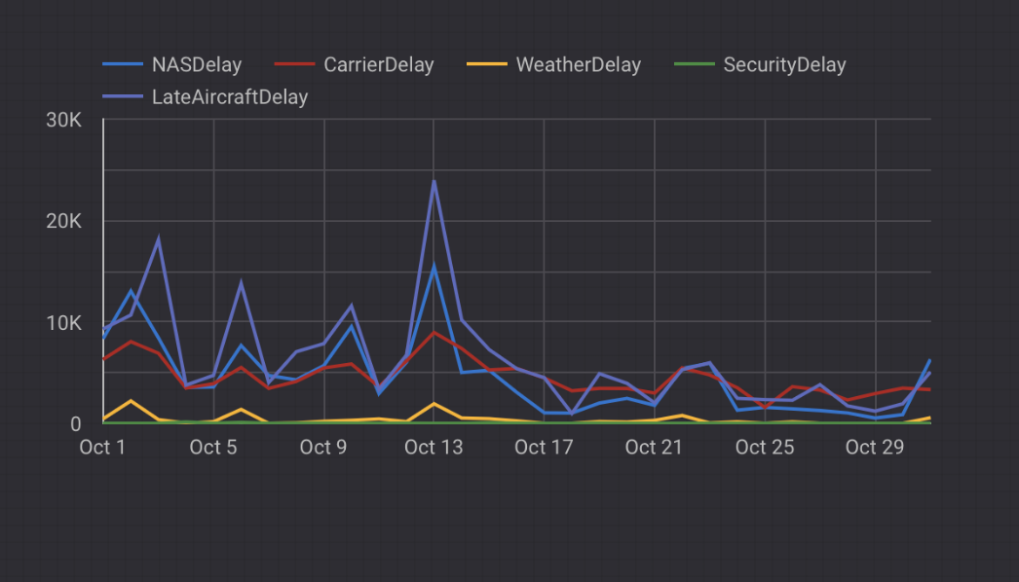
Causes of delay
Following visualization gives information about the various causes of delay and their day-to-day variation.
We can see that the major cause of delay on most days is Late Aircraft Delay.

Slide 7
Dashboard link
Link to the dashboard : https://datastudio.google.com/s/jvex2q9nAC8
Thank you!

